Slide 1
Unit Testing
Software Testing
BJ Rollison
Test Architect at Microsoft
Huy Dao
Test Lead at Microsoft
Nguyen Duc Man
Teaching Assistant
Duy Tan University

Slide 2

Lecture review

Slide 3
Objectives
Discuss unit testing contents, including:
•
•
•
•
What is unit testing?
Unit testing activities
Design unit test cases
Introduction to unit test tools
JUnit
IBM Rational Purify and Purecoverage
Others tools for Unit Testing
2

Slide 4
What is Unit Testing?
Definition
•
•
•
•
A software unit is a separately testable element specified in
the design of a software component.
A unit might be:
1. A procedure
2. A menu
3. A class
4. A web page or
5. A group of them
The most important characteristics of a unit is that it can be separated from others whether it is one or a group of procedures, menus, classes, web pages, etc.
Unit testing is the testing of individual software units or groups of related units.
3

Slide 5
Unit Test Activities
According to IEEE Std. 1008–1987 for Software Unit Testing, the main unit test activities include the following:
•
•
•
•
•
•
•
•
Plan the General Approach, Resources, and Schedule
Determine Features to be Tested
Refine the General Plan
Design the Set of Tests
Implement the Refined Plan and Design
Execute the Test Procedures
Check for Termination
Evaluate the Test Effort and Unit
Plan Unit Test
•
You may adopt your unit test plan based on the Test Plan Template.
4

Slide 6
Design Unit Test Cases
Design Unit Test Cases
•
•
A unit test is used to test the unit based on its logic and structure. It is often performed by the programmers who have developed the unit.
In order to design unit test cases, you may:
1. Determine the test units according to the software design.
2. Unit test cases are used for testing items of the unit, such as:
The interface
The local data structure
The logic structure: basis paths, decisions and loops
The error handling
Don’t forget the runtime characteristics such as memory
allocation, dynamic binding, runtime type information
etc. These are often ignored by the unit testers.
5

Slide 7
Design Unit Test Cases
Design Unit Test Cases
3. Applying testing techniques to design test cases. The most
often used unit testing technique is white-box testing, but
it doesn’t mean other techniques can not be applied. The
point is that the selected techniques should satisfy your
test requirements.
4. Implement the unit test cases either in documentation or
in test programs.
6

Slide 8
Build Unit Test Environment
Elements in unit test environments
•
•
•
•
Hardware and software to perform unit tests
Units to be tested
Unit test cases
Since a unit is a part of the whole system, it may not run alone. The following code will be developed in order to run the test code:
Driver is a piece of code emulating a calling function. It can replace the calling unit of the tested unit.
Stub is a piece of code emulating a called function. It can replace the called unit of the tested unit.
7

Slide 9
Execute Unit Tests
Approach
•
After completion of the unit test environment, you can run the unit test, step by step, according to the test case specification manually, with the help of unit test tools, or a combination of both.
Introduction to some often used unit test tools:
•
•
•
JUnit Framework
Get from http://sourceforge.net/projects/Junit/
IBM Rational Purecoverage
IBM Rational Purify
Get the trial version from IBM website at http://www-
306.ibm.com/software/sw-atoz/indexR.html
8

Slide 10


JUnit Framework
What is JUnit
•
•
It is a framework that can be used to develop unit testing in java.
The core JUnit classes used to run any JUnit test program is shown in the figure. The most often used class by a tester is TestCase.
《Interface》 TestSuite
BaseTestRunner
test
《Interface》
TestListener
Assert
TestCase
TestResult
9

Slide 11
Testing With JUnit
Install JUnit
1. Get Junit package.
2. Unzip the junit.zip file to your installation directory.
3. Add junit.jar to the CLASSPATH. For example: set
classpath=%classpath%;INSTALL_DIR\junit3\junit.jar
4. Test the installation by using either the batch or the graphical
TestRunner tool to run the tests that come with the release.
All the tests should pass OK. That is, the bar on the graphics
should be green. If the bar is red, it indicates there may be
something wrong with your program or test environment.
for the batch TestRunner type:
java junit.textui.TestRunner junit.samples.AllTests
for the graphical TestRunner type:
java junit.awtui.TestRunner junit.samples.AllTests
for the Swing based graphical TestRunner type:
java junit.swingui.TestRunner junit.samples.AllTests
10

Slide 12
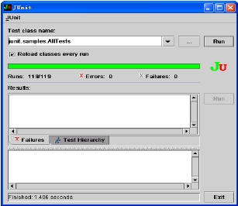
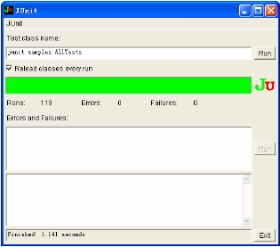
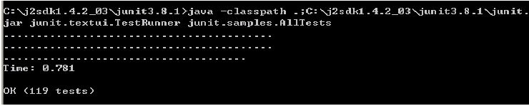
Testing With JUnit
Swing based graphical TestRunner
batch TestRunner
graphical TestRunner
11

Slide 13
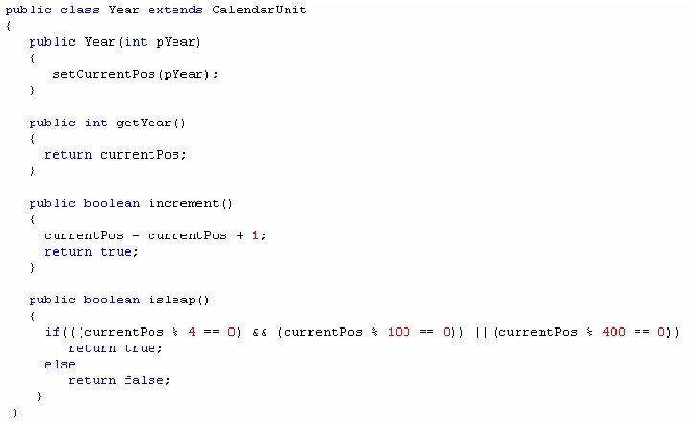
JUnit Example
•
Let’s test NextDate: using junit to test the isleap() method of the Year class.
12

Slide 14
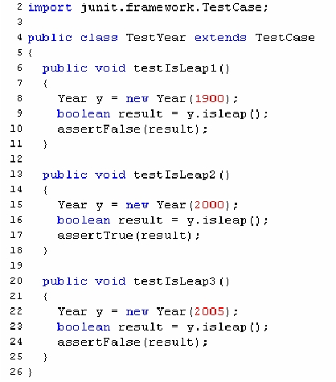
JUnit Example
By examining the isleap method,you
design three test cases: 1900, 2000,
2005.
Implement the test cases using Junit.
1.
2.
3.
4.
5.
6.
Developing a test class extends
TestCase of Junit Framework (line 4).
Develop a method and ensure the name
of the method follows the patten
testXXX() (line 6).
Create an instance of the class under
test (line 8).
Execute the test by calling the method
to test (line 9).
Compare runtime result with the
expected result (line 10).
By now you have developed one test
case in Junit. From lines 13 to 25… the
other two test cases.
13

Slide 15
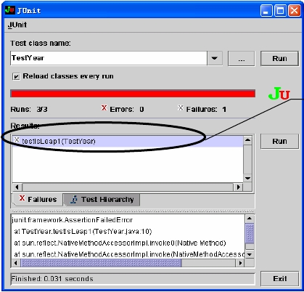
JUnit Example
•
After compiling the source file, run the “TestYear.class” using swing testrunner. You will find the bar is red which indicates there may be defects in your tested program.
Code related to testLeap1
may have problems
14

Slide 16
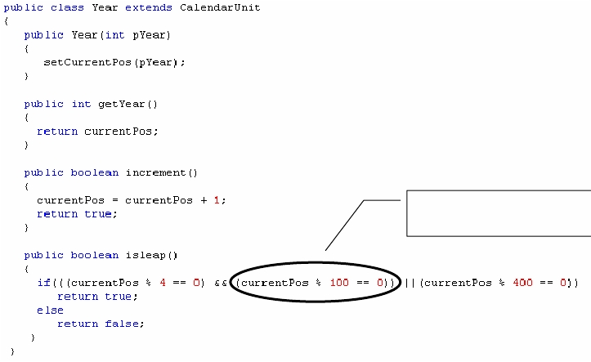
JUnit Example
•
Examine the code and fix defects.
(!(currentPos % 100 == 0)
15

Slide 17
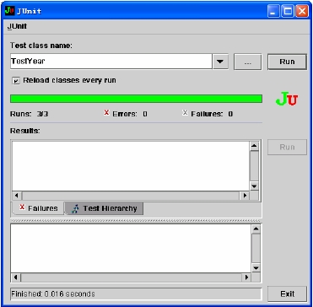
JUnit Example
•
After modification(s), run the Junit test program again to ensure the defect(s) are fixed. This time the bar becomes green which means no problems existing.
16

Slide 18
Extend JUnit
Enforce JUnit by combining with the following tools or
techniques:
•
•
•
•
•
•
Ant : http://Ant.Apache.org
Eclipse
Maven: http://maven.apache.org/
Jetty: http://jetty.mortbay.org/jetty/index.html
Mock Objects
Cactus: http://jakarta.apache.org/cactus/
17

Slide 19
Rational Purecoverage
Rational Purecoverage
•
Can help you check all your code developed in .NET, Java,
Visual C/C++, and Visual Basic and provide the code
coverage information.
How to run purecoverage
•
There are three methods that you can run purecoverage:
1. From purecoverage standalone user interface.
2. From specific IDE such as Microsoft Visual Studio 6, Visual
Studio .NET 2012, and IBM WebSphere Studio.
3. From the command line.
18

Slide 20
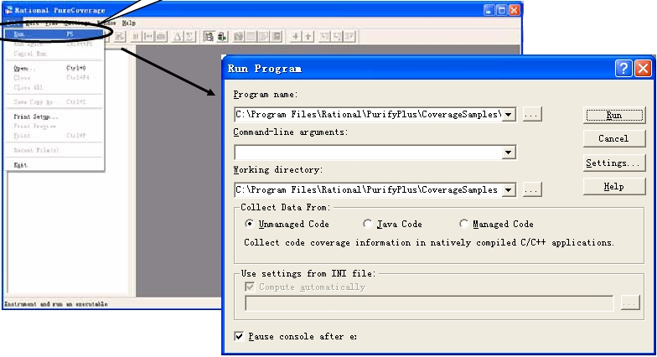
From Standalone User Interface
File-
>Run…
19

Slide 21
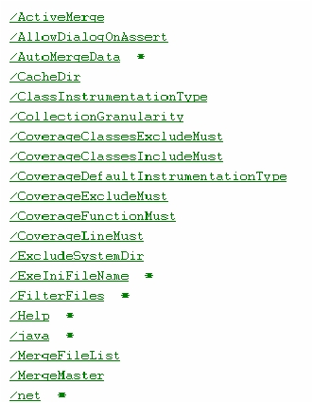
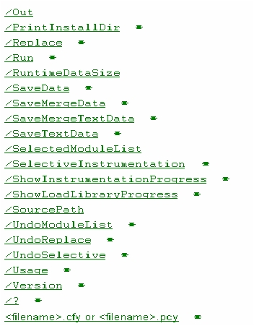
From Command Line
Command Line
•
coverage [<PureCoverage options>]
Purecoverage options
20

Slide 22
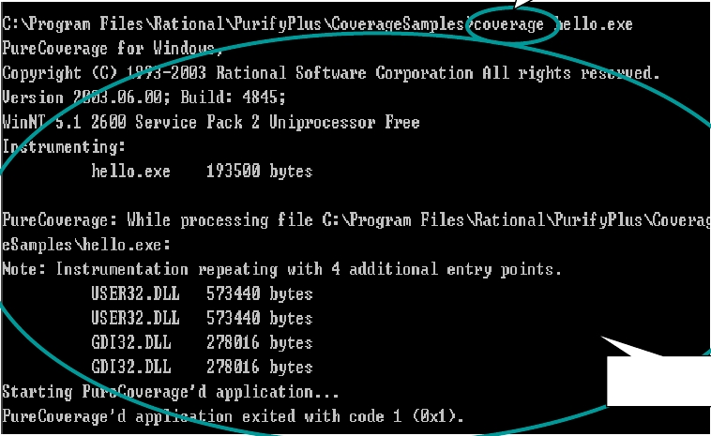
From Command Line
Command
Runtime
information
21

Slide 23
Check Code Coverage
Steps in running purecoverage from standalone user interface:
•
•
•
Design test cases.
Run the tested program with purecoverage until all the test
cases are executed.
Merge all valid coverage results to get final code coverage
information.
I’ll take the purecoverage sample file “Hello.exe” (in “purecoverage
installdir\PurifyPlus\\CoverageSamples\hello.exe”) for example to
show you how to check your code coverage.
22

Slide 24
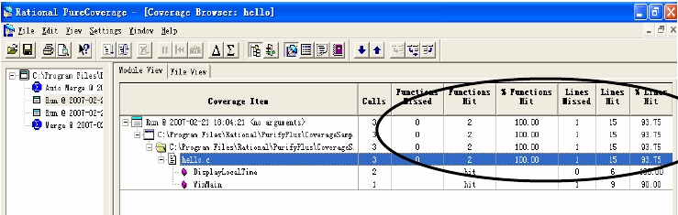
Check Code Coverage
Design test cases
•
Based on the source code, I get the following two test cases:
1. Click Yes, to see the time of the day
2. Click No, not to see the time of the day
Run each test case to collect coverage information:
•
Click yes and the coverage information is displayed
23

Slide 25
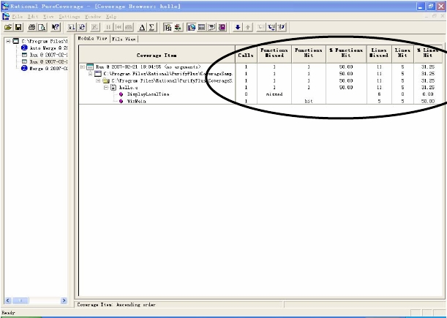
Check Code Coverage
Run each test case to collect coverage information.
•
Click no and the coverage information is displayed
24

Slide 26
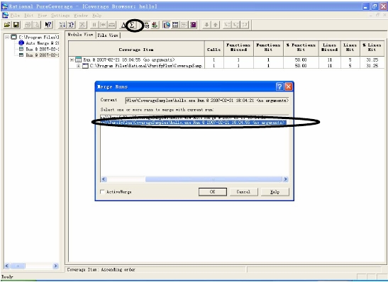
Check Code Coverage
Merge all valid coverage results to get final code coverage information, click the “Merge” button on the toolbar and select the coverage information to be merged.
25

Slide 27
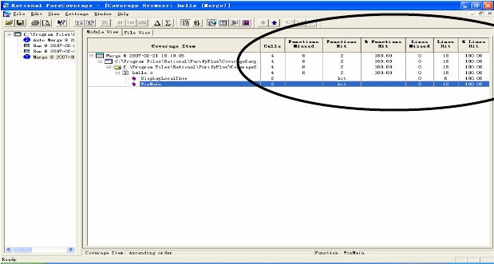
Check Code Coverage
In the final coverage information, you will see the code is 100% covered.
If the final coverage result is not 100%, you may design extra test cases to execute the uncovered code.
26

Slide 28
Rational Purify
Rational Purify can locate:
1. Memory management problems at the method and object
level in .NET and Java applications.
2. Run-time errors and memory leaks in native-compiled Visual
C/C++ applications.
How to run purify:
•
Like that of purecovery, there are three methods that you can run purify:
• From purify standalone user interface.
• From specific IDE such as Microsoft Visual Studio 6, Visual
Studio .NET 2012 and IBM WebSphere Studio.
• From the command line.
27

Slide 29
Detect C/C++ Memory Leak
Approach
To detect C/C++ program runtime errors, just run your
program with Purify. Purify will collect what you need.
•
I’ll take the purify sample c file “Hello.c” for example, to show
you how to detect C memory leaks, step by step, in the next
several slides.
28

Slide 30
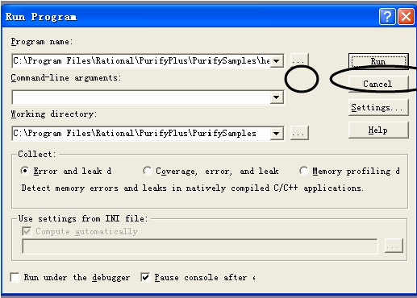
Detect C/C++ Memory Leak
Step 1. Browse to the sample file under your “purify installdir\PurifyPlus\PurifySamples\hello.c”, Click Run.
29

Slide 31
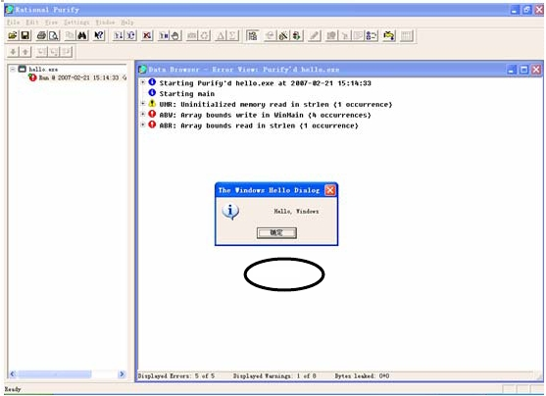
Detect C/C++ Memory Leak
Step 2. Wait while purify instrument finishes your program, then
click the “OK” button of the tested program window.
OK
30

Slide 32
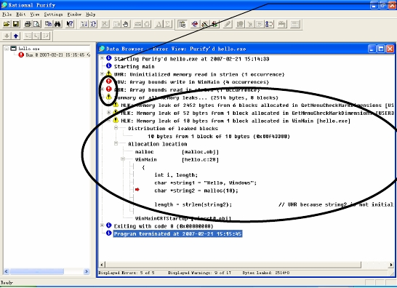
Detect C/C++ Memory Leak
Step 3. Purify displays the result in the data browser window.
These colored
icons indicate
that there may
be runtime errors
in your program.
Memory leak
information
31

Slide 33
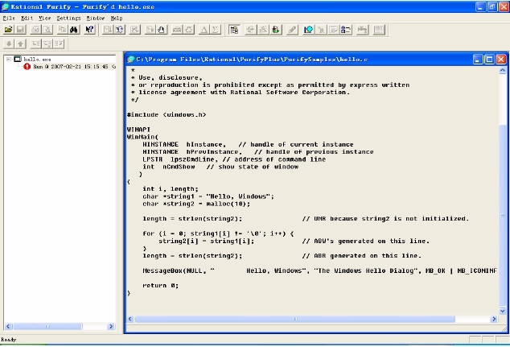
Detect C/C++ Memory Leak
Step 4. Examine the suspect code to fix the defects.
32

Slide 34
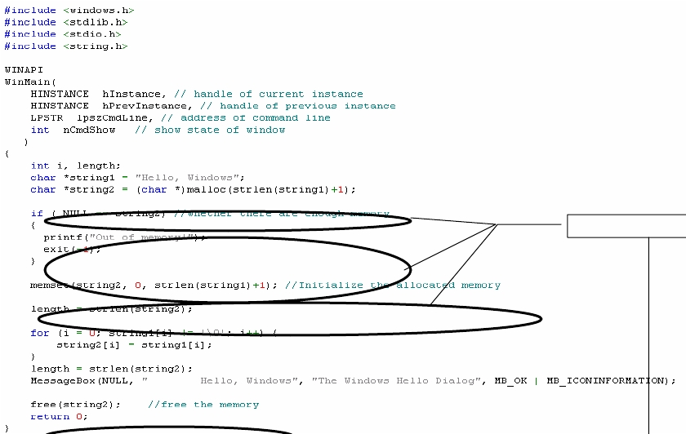
Detect C/C++ Memory Leak
modifications
33

Slide 35
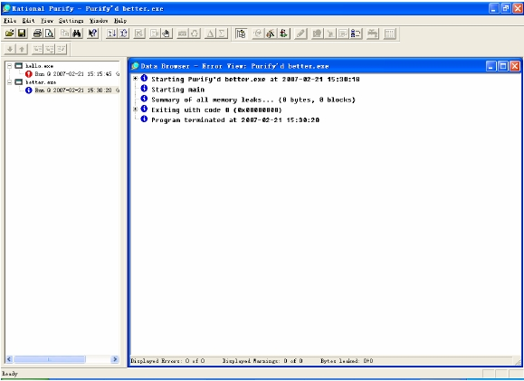
Detect C/C++ Memory Leak
Step 5. This time repeat steps 1 to 4 to run the modified “better.c”. Wow~~~, the results look so nice!
34

Slide 36
Detect Java Memory Leak
To profile and analyze memory usage for a program, follow these steps:
1. Run your Java or .NET managed program with Purify.
2. Wait until your program has finished initializing, then take a snapshot.
3. Run code you suspect may be leaking, then take another snapshot.
4. Compare the two snapshots to identify specific methods that
may be causing memory problems.
5. Examine suspect methods for unneeded objects, or objects containing references to unneeded objects that should be garbage-collected.
I’ll take the purify sample java file “LeakSample.java” for
example, to show you how to detect java memory leaks, step by
step, in next several slides.
35

Slide 37
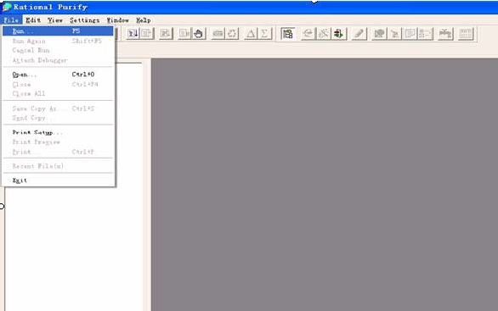
Detect Java Memory Leak
Step 1. Run Purify
36

Slide 38
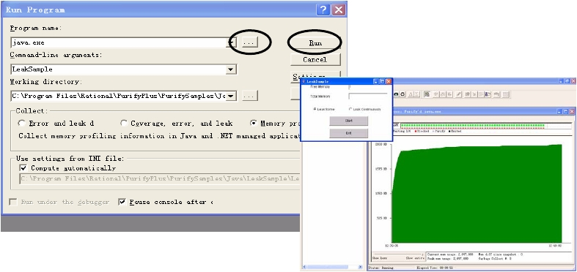
Detect Java Memory Leak
Step 2. Browse to the sample file under “purify
installdir\PurifyPlus\PurifySamples\Java\LeakSample\LeakSample.class”,
Click Run and the smaller window appears.
37

Slide 39
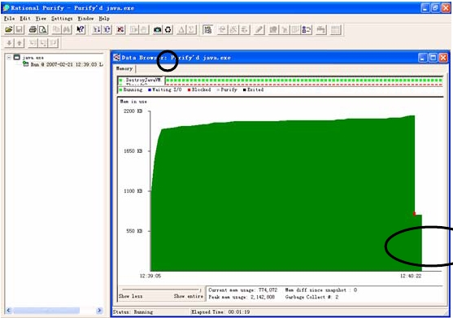
Detect Java Memory Leak
Step 3. Wait until the tested program has finished initializing,
click the “Garbage Collect” button on the toolbar to take the first
snapshot of the memory.
38

Slide 40
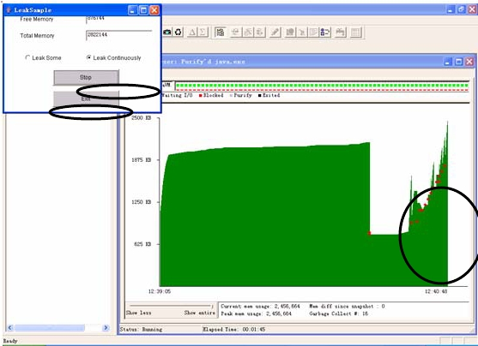
Detect Java Memory Leak
Step 4. Choose “Leak Continuously” and Click the “start” button of the tested program. You will find the memory in use increase accordingly. The red dots are garbage collection points generated automatically by your java program.
39

Slide 41
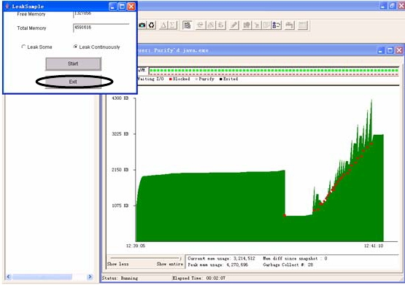
Detect Java Memory Leak
Step 5. Click the “stop” button of the tested program.
40

Slide 42
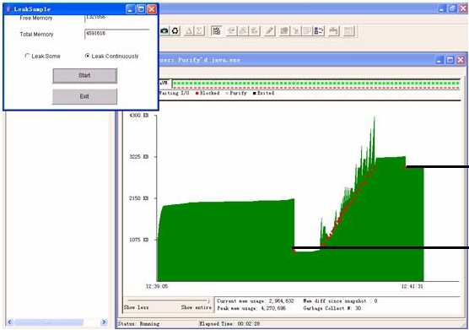
Detect Java Memory Leak
Step 6. Click the “Garbage Collect” button on the toolbar again to take the second snapshot. You will find there is a memory gap between the two snapshots. That means perhaps there is memory leak in your tested program.
memory gap
41

Slide 43
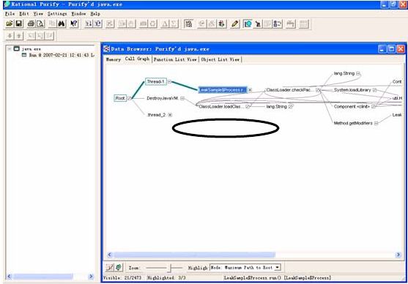
Detect Java Memory Leak
Step 7. Click the “Exit” button of the tested program and the “data browser window” opens with the method ”LeakSample$Processor” highlighted.
42

Slide 44
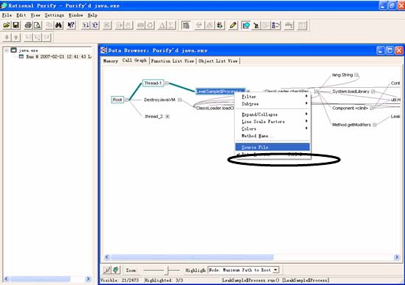
Detect Java Memory Leak
Step 8. Right click on the ”LeakSample$Processor” and select Source File.
43

Slide 45
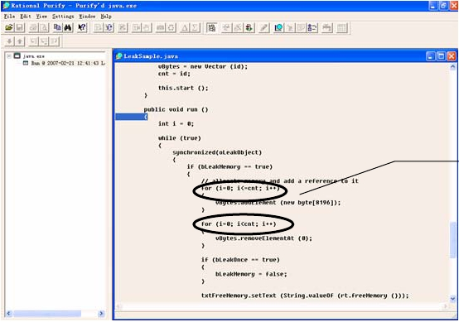
Detect Java Memory Leak
Step 9. The source file of ”LeakSample.java” is displayed for you
to examine suspect method and fix the defect.
Problem is here
44

Slide 46
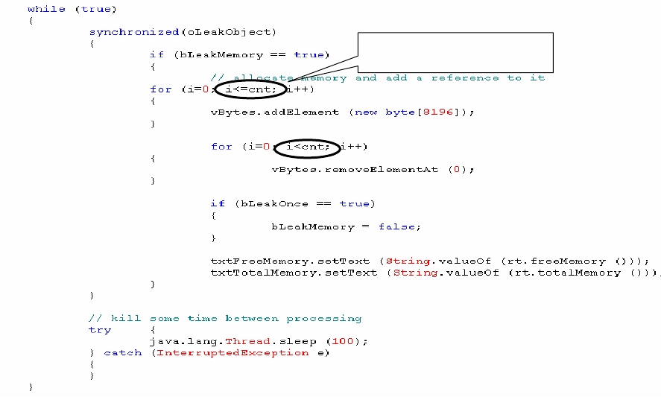
Detect Java Memory Leak
Modify to for (i=0;
i<cnt; i++)
45

Slide 47
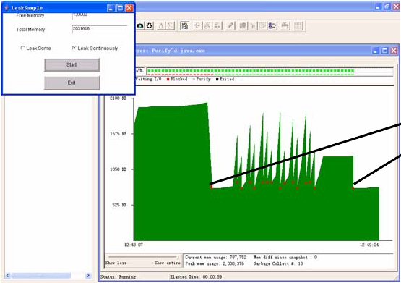
Detect Java Memory Leak
Step 10. This time repeat steps 1 to 9 to run the modified
“LeakSample.java”. You will see the memory gap doesn’t exist.
No memory gap
46

Slide 48
Other Unit Test Tools
Static Analysis Tools
•
•
PC-Lint for C/C++
Logiscope
The series of XXUnit tools (all can be obtained from
http://sourceforge.net/)
•
•
•
•
•
•
C Unit testing Framework
NUnit for C#
DUnit for Delphi
XML Unit
JsUnit for client-side JavaScript
SimpleTest for PHP
47

Slide 49
Unit Test Report
Important contents
•
A unit test report summarizes the entire process of unit
testing and can provide a lot of useful information. This
information can be used for process improvement, such as:
Number of planned test cases
Number of modified test cases
Number of deleted test cases
Number of executed test cases
Number of unexecuted test cases and the reasons
Number of found defects based on severity
Number of suspended defects
Evaluation of the tested unit and improvement suggestions
48

Slide 50
Suggestions
The following may be helpful:
•
•
•
•
•
•
•
•
•
•
Perform code review before unit test.
Assign the programmer who implemented the unit to perform unit tests.
Modify unit test cases after finishing coding.
Remember to test runtime problems.
Keep your test program as simple as possible.
Develop test programming conversions.
Simplify the defect tracking process when the programmer performs unit tests.
Ensure the defects get fixed without side-effects.
Report unit test defects.
Store unit defect reports.
49

Slide 51
Summary
Unit testing is the process of testing a unit of software. It is often performed by the programmer who developed it.
The main unit test activities include:
• Plan for unit tests
• Design unit test cases
• Build unit test environment
• Execute unit test
• Report unit test
Unit test tools can be very helpful.
Static analysis tools and some dynamic test tools can be used in unit tests.
50

